Slide 1

Laptop Market Analysis Using
Web Scraping and EDA

Slide 2

TITLE:
Laptop Market Analysis Using
Web Scraping and EDA

Slide 3
INTRODUCTION
The project collects laptop data from websites using web scraping.
It uses EDA (Exploratory Data Analysis) to study laptop market trends.
The goal is to understand prices, brands, features, and specifications.
Python tools like BeautifulSoup, Pandas, Matplotlib, and Seaborn are used for analysis.
BeautifulSoup helps extract data from websites by reading the HTML code.
It shows which brands give better value and how prices change with features.
The project gives a clear view of the laptop market and helps in smart buying decisions.

Slide 4
BUSINESS PROBLEM
There are many laptop brands and models, making it hard for buyers to compare and choose the best option.
Laptop prices and features keep changing frequently on different e-commerce websites.
Customers often face confusion about which brand offers better value for their money.
Businesses and sellers lack clear insights into market trends, popular features, and customer preferences.
There is no single dataset available that combines all laptop details, prices, and specifications in one place.
To solve this, web scraping is used to collect data, and EDA helps to analyze and visualize market patterns and trends.

Slide 5
OBJECTIVES
To collect laptop data (brand, price, specifications, rating, etc.) from online websites using web scraping.
To clean and organize the data for easy understanding and analysis.
To analyze laptop prices, features, and brands to find useful patterns and trends.
To compare different brands and identify which gives better value for money.
To create visualizations that show market trends, price ranges, and popular features.
To help buyers and businesses make data-driven decisions based on real market insights.

Slide 6
The Dataset & Target Variable
Source: https://www.flipkart.com/
Scope: 904 laptop models , 8 Features.
Key Features:
Performance:
RAM, Processor Type, Rating (represents speed, quality, and performance).
Storage & Display:
ROM (Storage Capacity), Display Size (in inches).
Brand & Model:
Brand Name, Model Name — help in comparing different laptop brands and series.
Price:
Laptop Price (₹) — varies with specifications and brand.
Target Variable: Price (₹) — represents the market price of the laptop, used to analyze value and performance differences.

Slide 7
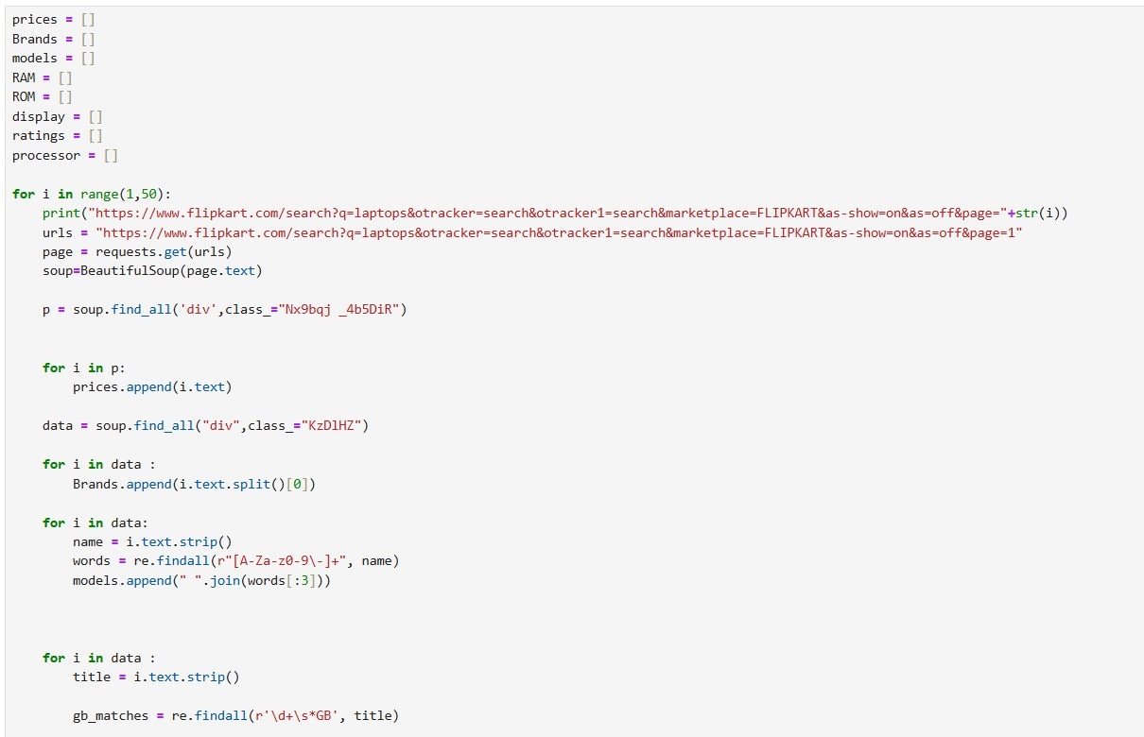
Web Scraping
.
Extracted laptop data from trusted e-commerce websites using Python.
Used BeautifulSoup and Requests libraries to scrape product details efficiently.
Collected key attributes such as Brand, Model, Processor, RAM, ROM, Display Size, Rating, and Price.
Cleaned and structured the scraped data into a CSV file for further analysis.
Ensured data accuracy by removing duplicates and fixing missing or inconsistent values.
The final dataset was ready for Exploratory Data Analysis (EDA) to identify market trends and insights.

Slide 8






TOOLS USED

Slide 9
Data Cleaning Steps
Removed missing and duplicate values from the dataset.
Fixed inconsistent units in RAM, ROM, and Display columns.
Filled missing ratings with the average rating of similar brands.
Standardized Processor names and filled missing ones with common values.
Converted Price and Rating to numeric format for analysis.
Result:
A clean, well-structured dataset with accurate values — ready for Exploratory Data Analysis (EDA) and visualization.

Slide 10
PART 1: UNIVARIATE ANALYSIS

Slide 11
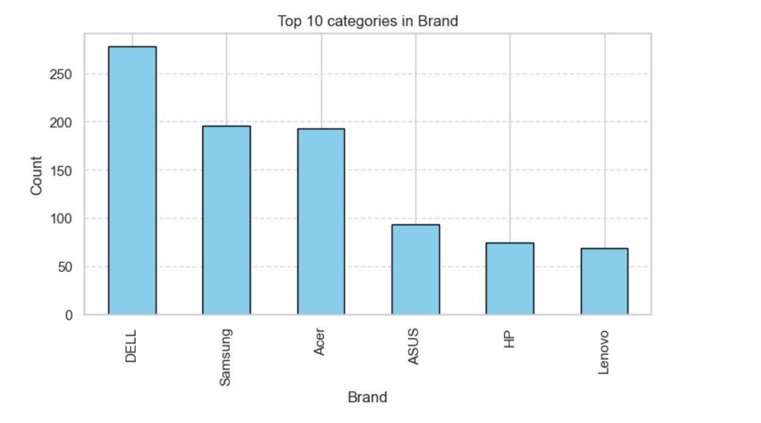
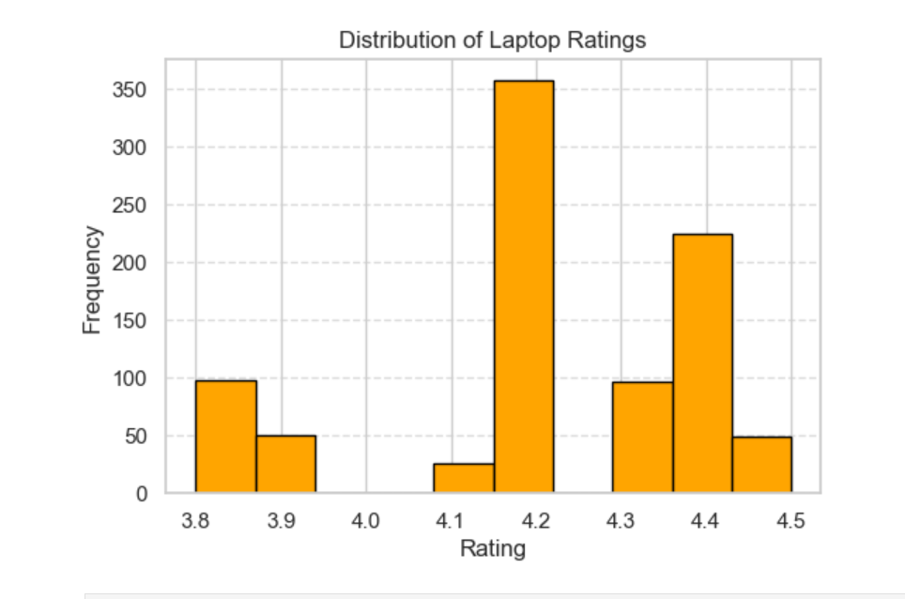
Brand Market Share Analysis
Market Leaders:
DELL (30.8%), Samsung (21.7%), and Acer (21.4%) are the top brands dominating the laptop market.
Mid-Level Brands:
ASUS (10.3%), HP (8.2%), and Lenovo (7.6%) hold smaller but significant shares.
Top 3 Brands:
Together, the Top 3 brands control 73.9% of the laptop market.
Market Concentration:
The laptop market shows a high concentration among a few leading brands.
Long Tail:
A few other brands exist but have a very small market presence compared to the top ones.
Insight:
The market is competitive yet brand-dominant, with DELL, Samsung, and Acer leading the segment.

Slide 12
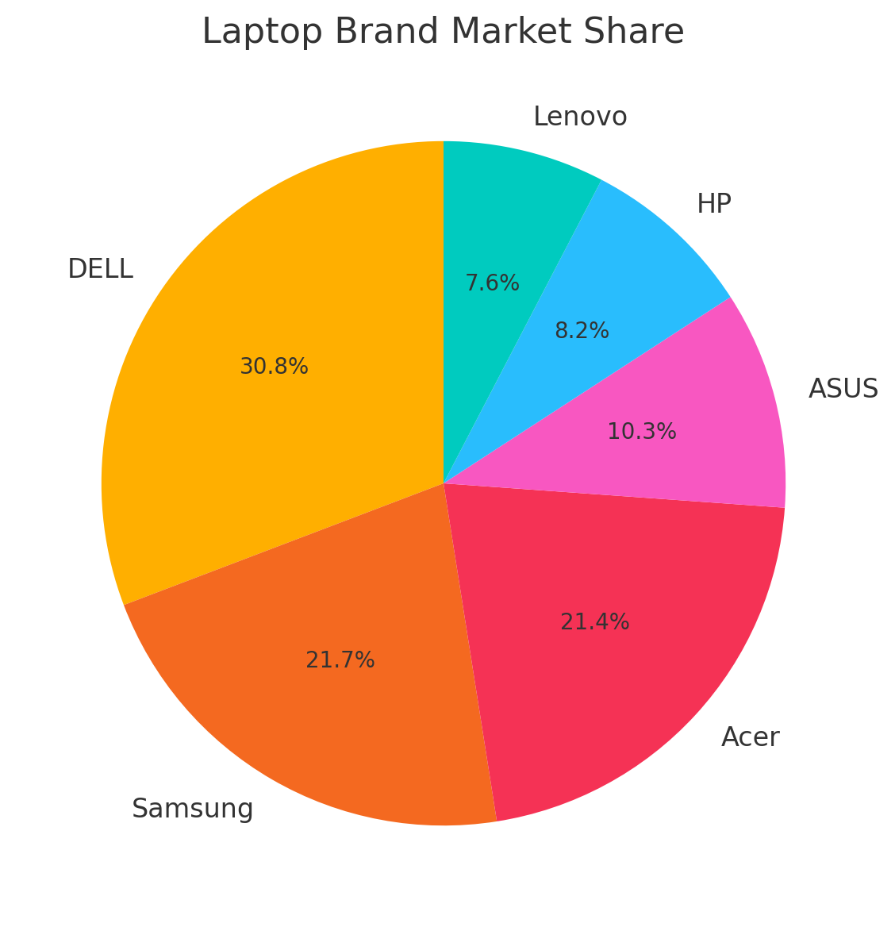
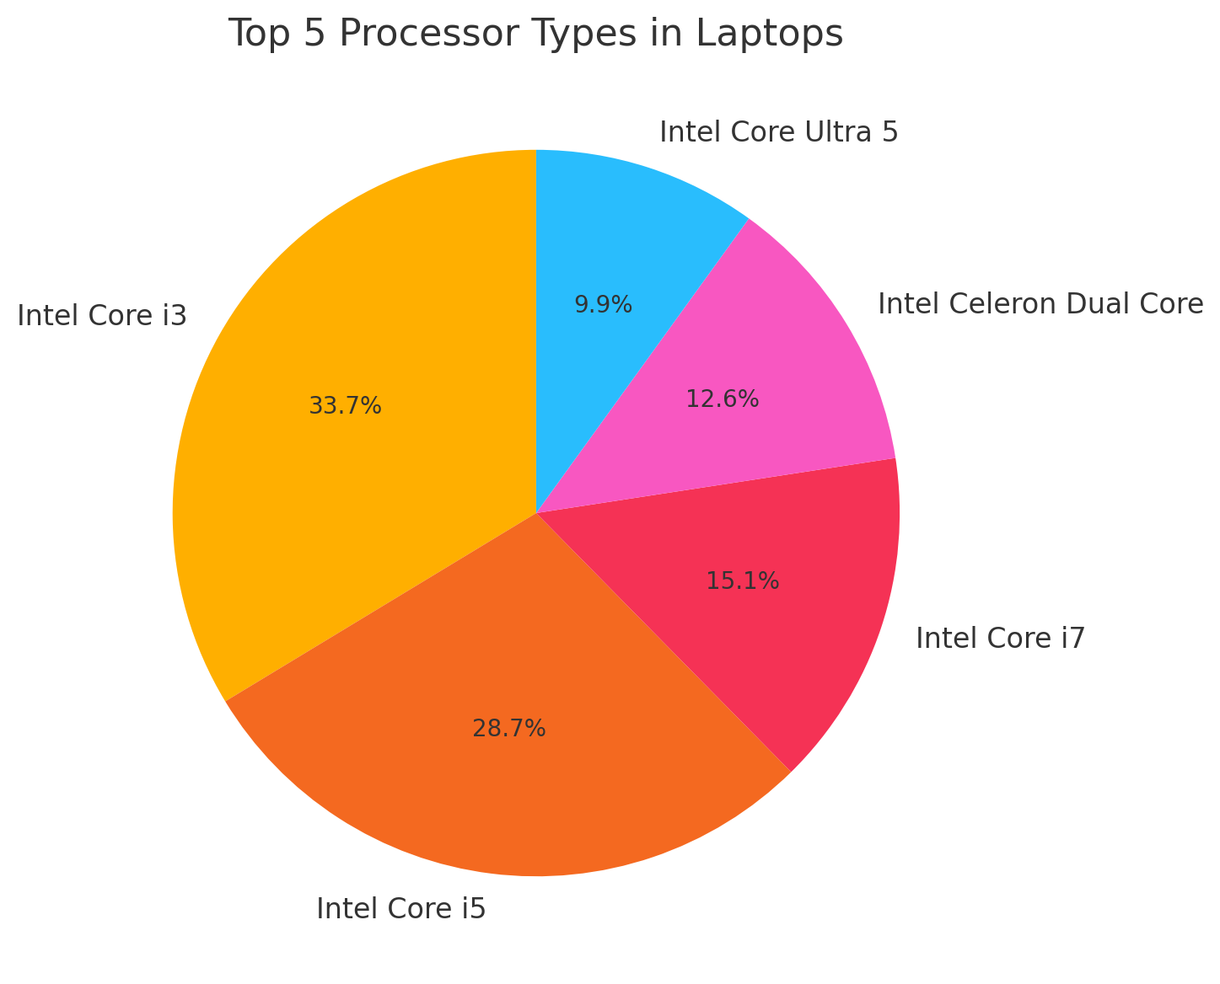
Key Performance Metrics Distribution
.Average Price: Around ₹44,000, most laptops range between ₹35K–₹55K.
Lowest & Highest Price: From ₹15,990 to ₹75,490.
Average Rating: Around 4.2, showing good overall quality.
Ratings Range: Between 3.8 and 4.5 across brands.
Mid-range laptops are most common in the dataset.
High-end models (above ₹70K) offer premium performance and specs.

Slide 13
PART 2: BIVARIATE ANALYSIS

Slide 14
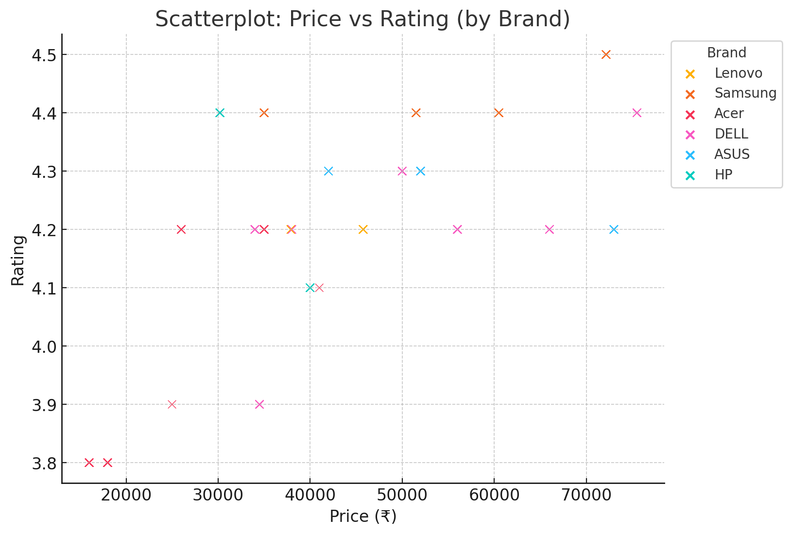
Critical Performance Relationships
Price vs Rating:
Price and rating have a weak relation — expensive laptops don’t always get higher ratings.
Price vs RAM:
More RAM → Higher Price (16 GB and 32 GB laptops are costlier).
Price vs Brand:
ASUS and Samsung are premium brands, while Acer and HP are budget-friendly.
Rating vs Brand:
Samsung has the best ratings, showing high customer satisfaction.
Price vs Processor:
Core i7 and Ultra 5 laptops are most expensive, while i3 and Celeron are low-cost options.

Slide 15
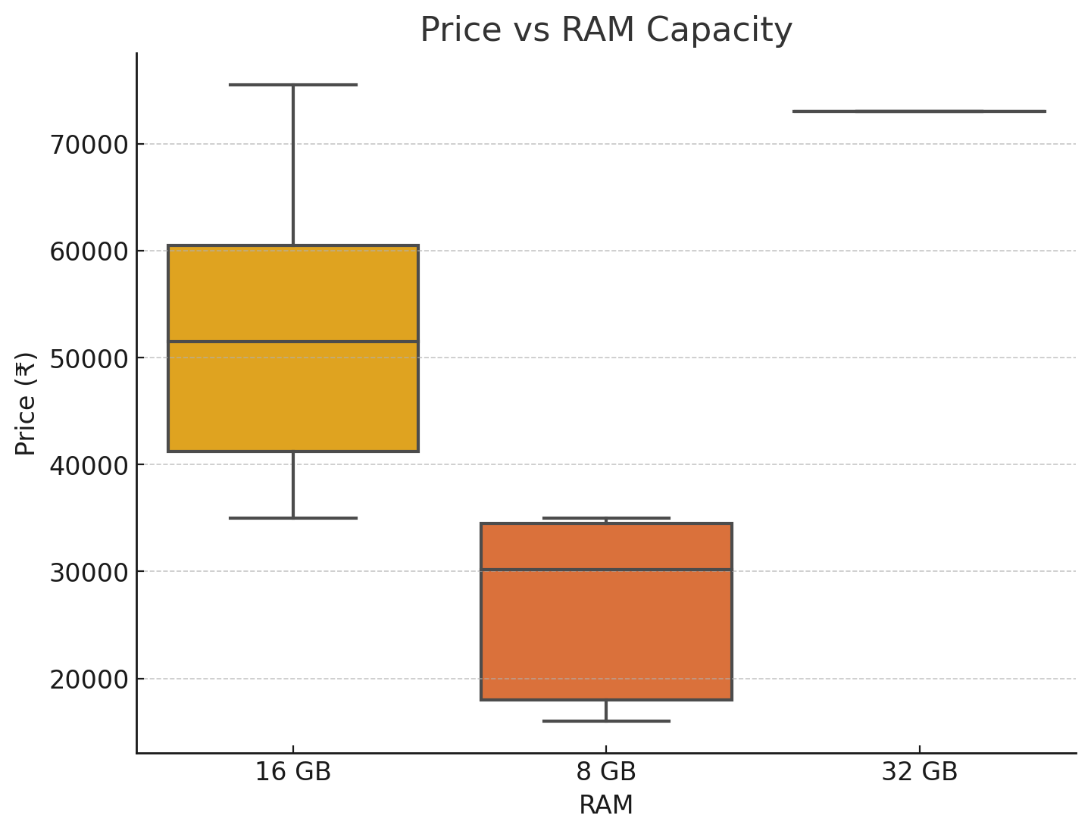
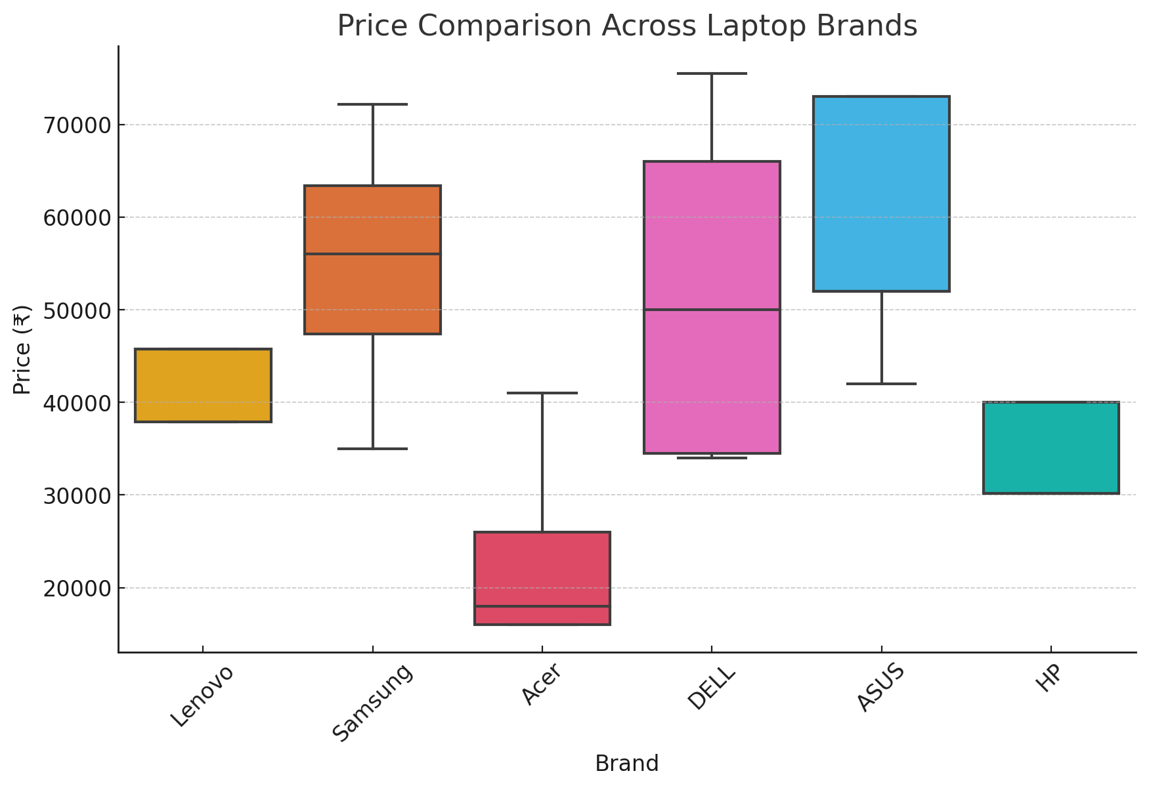
Brand Performance Positioning
ASUS & Samsung – Lead in performance and price, premium laptops.
DELL – Offers balanced quality at mid to high price range.
Acer & HP – Budget-friendly with good performance.
Samsung – Highest customer ratings (~4.4–4.5).
Lenovo – Reliable brand with mid-range models.

Slide 16
PART 3: MULTIVARIATE ANALYSIS

Slide 17
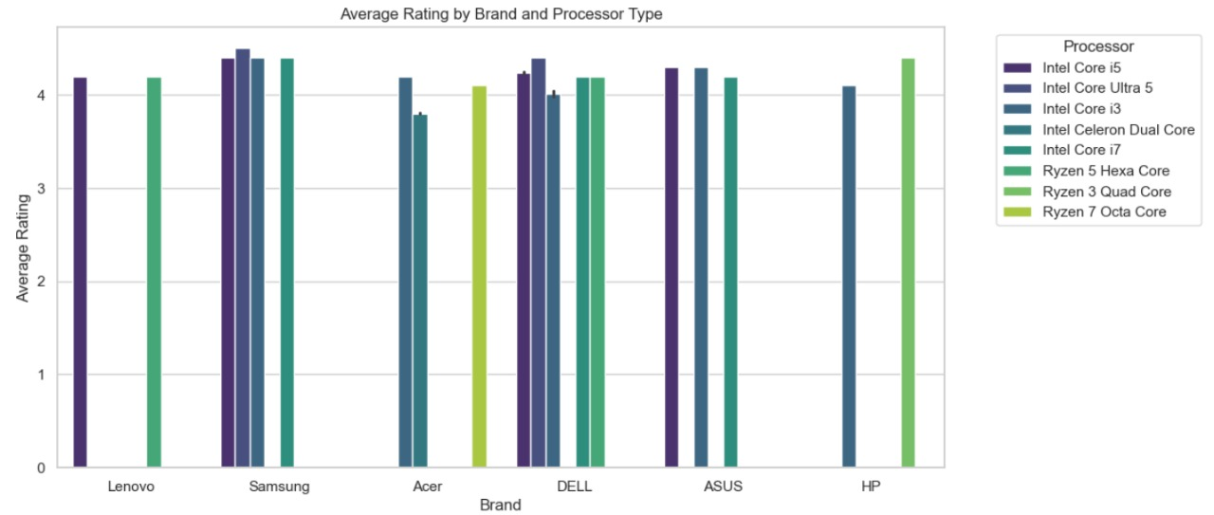
Multi Variate Analysis
All brands have ratings above 4, so customers are happy.
Samsung, DELL, and ASUS have the best ratings.
Acer and HP have slightly lower ratings but still above 3.8.
Better processors (i5, i7, Ryzen 5, etc.) get better ratings.
Basic processors (i3, Celeron, Ryzen 3) get lower ratings, but still okay.
DELL and ASUS perform well with any processor.
Ratings depend more on processor quality than brand name.
Ratings are mostly similar across brands, showing a stable market.

Slide 18
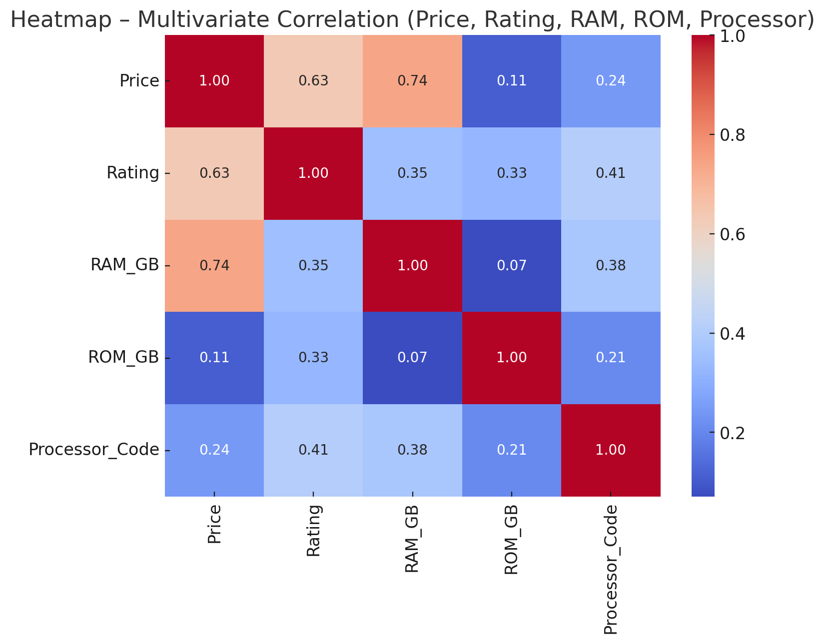
Correlation Patterns
Price increases when RAM increases → more RAM = higher price.
Price also increases with better processors, but not as much as RAM.
Expensive laptops get slightly better ratings → small positive link.
Storage (ROM) does not affect price much → very weak relation.
Ratings go up a little with better processors and more RAM, but the effect is small.
RAM and Processor usually go together → higher RAM laptops often have better processors.
RAM and ROM have no link → they don’t depend on each other.

Slide 19
Key Business Insights & Recommendations
RAM drives performance and pricing – Laptops with higher RAM (16GB/32GB) have better performance and higher prices.
Processor type impacts value – Core i7 and Ultra 5 models dominate the premium market, while i3 and Celeron suit budget buyers.
Brand value matters – ASUS, Samsung, and DELL charge more even for similar specs, showing strong brand influence.
Customer satisfaction is stable – Ratings stay around 4.1–4.4, proving consistent quality across brands.
Clear market segmentation –
Budget: Acer, HP – under ₹35K
Mid-Range: DELL, Lenovo – ₹35K–₹55K
Premium: ASUS, Samsung – above ₹55K
Recommendation: Focus on balanced specs and pricing, as customers prefer value for money over luxury branding.

Slide 20
Conclusion
The laptop market is growing steadily, showing healthy competition between top brands like DELL, ASUS, Samsung, and emerging ones like Acer and HP.
Continuous improvements in RAM capacity, processor performance, and storage speed are driving market trends and customer choices.
Brands follow different strategies — from performance-focused laptops (ASUS, Samsung) to budget-friendly options (Acer, HP), catering to varied user needs.
The market shows clear segmentation across Budget, Mid-Range, and Premium categories based on price and specs.
A growing focus on value for money, brand trust, and user satisfaction will shape the future of laptop sales.

Slide 21
Experience – Web Scraping & Data Analysis
Web Scraping: Collected real-world laptop data from online shopping websites using Python (BeautifulSoup & Requests).
Data Cleaning: Processed and standardized the data — removed duplicates, handled missing values, and corrected formatting issues.
Exploratory Data Analysis (EDA): Analyzed price, brand, RAM, processor, and rating trends using Pandas, Matplotlib, and Seaborn to find hidden patterns.
Insights Generation: Identified brand performance, price vs specs relations, and market segmentation (Budget, Mid-Range, Premium).
Practical Outcome: Built a clean, insight-rich dataset showing how price, performance, and brand influence customer choices in the laptop market.

Slide 22
Challenges – Web Scraping & Data Analysis
Data inconsistency: Laptop details were different on each website.
Missing data: Some laptops had incomplete specs or wrong values.
Data cleaning: Needed to fix symbols and text (like “GB”, “₹”) before analysis.
Standardization: Had to make RAM, storage, and processor formats uniform.
Visualization: Choosing the best charts to show brand and price trends clearly.

Slide 23


